Slide 1
Promoting Self-Regulation
Using the Zones of Regulation Developed by Leah Kuypers, MA Ed., OTR/L.
CPD by Claire Ashley

Slide 2
What is Self-Regulation?
Self-regulation is our ability to control our own thoughts, emotions, and behaviours in relation to our environment.
At WWJS we use the Zones of Regulation combined with emotional coaching to promote good self-regulation and emotional literacy.

Slide 3
Examples of Self-Regulation
Resisting an emotional outburst when something or someone upsets us
Focusing on work when distractions are near
Delaying gratification
Calming ourselves down when feeling anxious or worried
Transitioning from one task to another

Slide 4
The Zones Framework
What it IS NOT
A discipline model
A behaviour management tool
A reactive behaviour approach
A way to shame negative behaviour
Punitive in nature
What it IS:
A teaching tool
A thinking framework
A way to nurture development of social-emotional skills
A way to promote emotional literacy

Slide 5
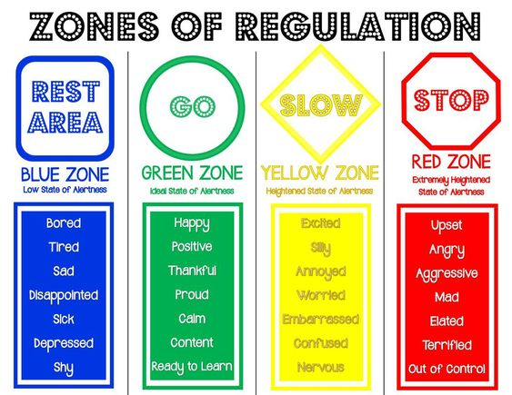

Slide 6
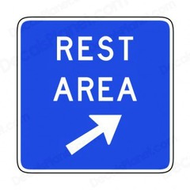
Blue Zone
Low state of alertness
Low energy
Slow to get started
Bored
Tired
Sad, Down in the dumps
Disappointed
Sick
Depressed
Shy

Slide 7
Green Zone
Ideal state of alertness
Just-right amount of energy
Gets started easily
Happy
Positive
Thankful
Proud
Calm
Content, Focused
Ready to Learn

Slide 8
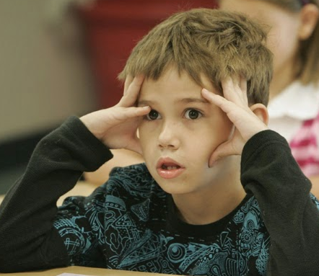
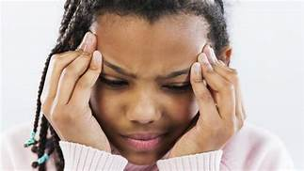
Yellow Zone
Heightened state of alertness
Keyed up, higher energy
Caution
Excited
Silly, Wiggly
Annoyed, Frustrated
Worried
Embarrassed
Confused
Nervous

Slide 9
Red Zone
Extremely high state of alertness
Very high energy
Difficulty working
Upset
Angry
Aggressive
Mad
Elated
Terrified
Out of control

Slide 10
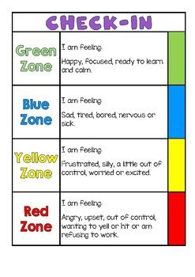
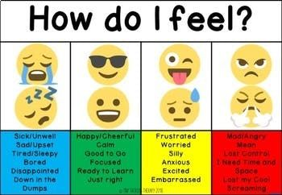
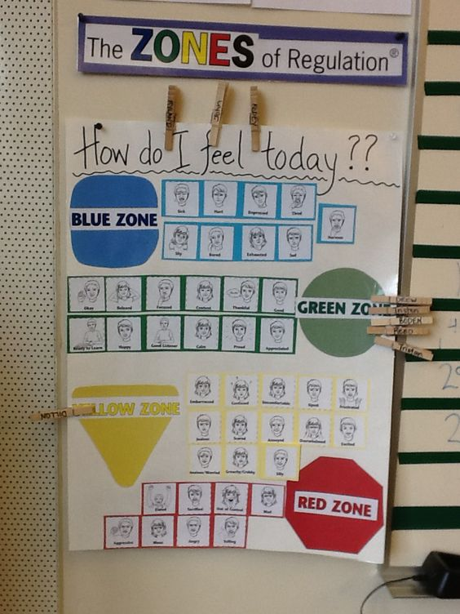
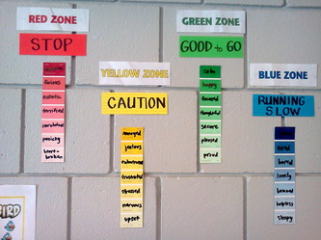
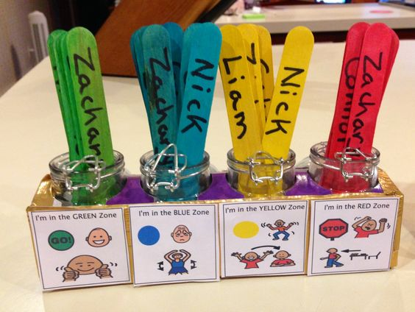
In school each class has a “Zones” display, children will have regular opportunities to alert adults to dysregulation and express their feelings.

Slide 11
How to use the Zones
Help your child to recognise their ‘zone’, discussing how this feels using three senses- “What does Green Zone look, feel and sound like .” Validate what Zone you and your children are in and help them brainstorm expected ways to self-regulate, using tools if necessary, so their behaviour is expected for the context. “This is really frustrating me and making me go into the Yellow Zone. I need to use a tool to calm down. I will take some deep breaths.” It is important to note that everyone experiences all of the Zones—the Red and Yellow Zones are not the “bad” or “naughty” Zones. We all experience all of the zones

Slide 12
Other useful phrases to label and validate feelings
Did it make you feel _____ when ______?
Were you feeling ______ when ______?
It sounds like that made you feel ________.
That would make me feel ________ too.
It makes me feel __________ when _______ happens also.
It looks like you’re very happy.
You seem a bit sad.
Are you feeling annoyed?
It sounds like you were really scared.
I bet that made you pretty grumpy.

Slide 13
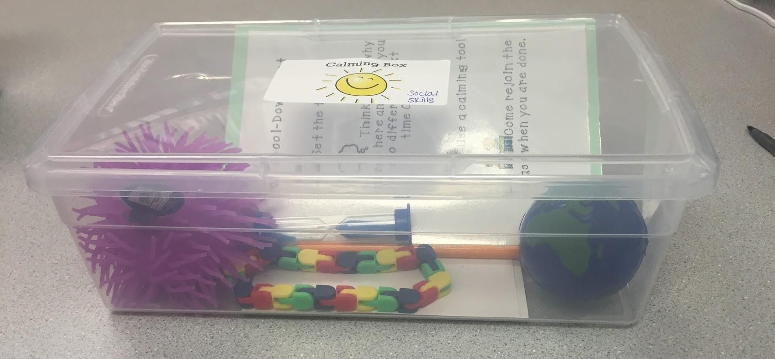
Using Tools
Create a toolkit together to help your child self-regulate
A kit could include :
Worry Stone
Cards with calming choices
Colouring
Sensory bottles
Stress ball
Breathing cards
Anything else you choose to add
Fidgets
Push /Pull something
Counting to 10 forwards/backwards
Drink a glass of water
So star jumps
Their emotional tool kit should always be available to the them !

Slide 14
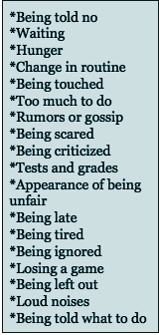
Understanding Triggers
A trigger is an irritant that causes a child to become less regulated
What pushes your buttons? What is a trigger for you?
Think of your dysregulated child . What triggers them? What can you do to be proactive?
We can intervene and be proactive- “ I can see that your sister has made you upset with her words, it looks like you might be in the blue zone, try this tool to help.”

Slide 15
The goal…the classroom:
The goal is for the child to be able to identify which zone they are in and how they are feeling. Then for them to choose a tool that is best for them before their behaviour escalates.
I am feeling _____ANXIOUS- Yellow_______.
(Know the zone.)
I need to ____CALM DOWN_______.
(Know if they need more energy or less energy.)
I can ____USE MY BREATHING CARDS_____________.
(Know what tool to use .)

