Slide 3




1) Convert these mixed numbers to improper fractions:
2) Convert these improper fractions to mixed numbers:
5 $\frac{\text{3}}{\text{5}}$
3 $\frac{\text{8}}{\text{9}}$
$\frac{\text{102}}{\text{10}}$
$\frac{\text{124}}{\text{12}}$

Slide 4

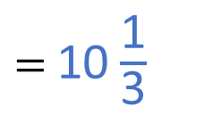

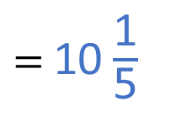
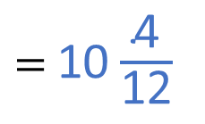

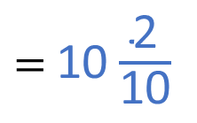



1) Convert these mixed numbers to improper fractions:
2) Convert these improper fractions to mixed numbers:
$=$ $\frac{\text{28}}{\text{5}}$
$=$ $\frac{\text{35}}{\text{9}}$
5 $\frac{\text{3}}{\text{5}}$
3 $\frac{\text{8}}{\text{9}}$
5 $\text{×}\frac{\text{5}}{\text{5}}=$ $\frac{\text{25}}{\text{5}}$
$\frac{\text{25}}{\text{5}}+$ $\frac{\text{3}}{\text{5}}$
3 $\text{×}\frac{\text{9}}{\text{9}}=$ $\frac{\text{27}}{\text{9}}$
$\frac{\text{27}}{\text{9}}+$ $\frac{\text{8}}{\text{9}}$
$\frac{\text{102}}{\text{10}}$
$=$ 10 $\frac{\text{2}}{\text{10}}$
$=$ 10 $\frac{\text{1}}{\text{5}}$
$\frac{\text{124}}{\text{12}}$
$=$ 10 $\frac{\text{4}}{\text{12}}$
$=$ 10 $\frac{\text{1}}{\text{3}}$

Slide 6
$\frac{\text{7}}{\text{5}}$ $−$ $\frac{\text{3}}{\text{10}}$ $=$
$$\frac{\text{11}}{\text{10}}$$
or 1 $\frac{\text{1}}{\text{10}}$
$×$ 2
$$\frac{\text{1}\text{4}}{\text{10}}$$

Slide 7
$$\frac{\text{7}}{\text{5}}−\frac{\text{3}}{\text{10}}$$
$$=\frac{\text{11}}{\text{10}}$$
$$=\text{1}\frac{\text{1}}{\text{10}}$$
$\frac{\text{14}}{\text{10}}$
$\frac{\text{3}}{\text{10}}$
$\frac{\text{7}}{\text{5}}$
$\text{+}\frac{\text{7}}{\text{10}}$
$\text{+}\frac{\text{4}}{\text{10}}$
0
1
2
$\frac{\text{10}}{\text{10}}$
$\frac{\text{20}}{\text{10}}$
$\frac{\text{5}}{\text{5}}$
$\frac{\text{10}}{\text{5}}$
$\frac{\text{7}}{\text{10}} \text{+} \frac{\text{4}}{\text{10}} \text{=} \frac{\text{11}}{\text{10}}$

Slide 8
Have a think
$$\text{2}\frac{\text{2}}{\text{3}}−\frac{\text{7}}{\text{9}}$$
$=$ $\text{1}\frac{\text{8}}{\text{9}}$
$$\text{+} \frac{\text{2}}{\text{9}}$$
$+\frac{\text{6}}{\text{9}}$
$\text{+}$ 1
0
$$\frac{\text{7}}{\text{9}}$$
1
2
$$\text{2}\frac{\text{2}}{\text{3}}$$
3
$$\text{2}\frac{\text{6}}{\text{9}}$$
$$\frac{\text{2}}{\text{9}}+\frac{\text{6}}{\text{9}}+\text{1}$$
$=$ $\text{1}\frac{\text{8}}{\text{9}}$

Slide 9
Have a go at questions 1 - 2 on the worksheet

Slide 10
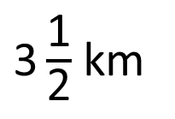
A race is 3 $\frac{\text{1}}{\text{2}}$ km in length.
Have a think
$\text{3}\frac{\text{1}}{\text{2}}$ km
Annie has run 1 $\frac{\text{1}}{\text{8}}$ km so far.
How much further does she have to run?

Slide 11

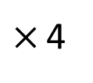
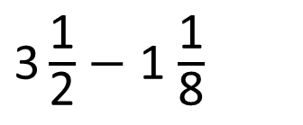
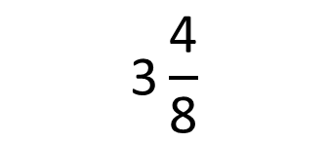
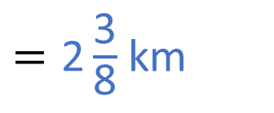
$\text{3}\frac{\text{1}}{\text{2}}$ $−$ 1 $\frac{\text{1}}{\text{8}}$
$=\text{2}\frac{\text{3}}{\text{8}}$ km
$$\text{3}\frac{\text{1}}{\text{2}}$$
$$\frac{\text{1}}{\text{8}}$$
$−$ 1
$×$ 4
$$\text{3}\frac{\text{4}}{\text{8}}$$

Slide 12
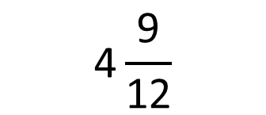
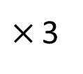
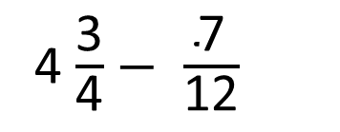
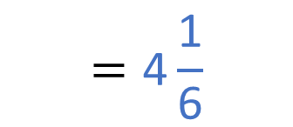
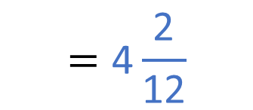
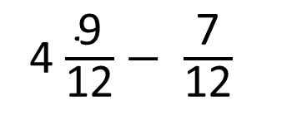
4 $\frac{\text{3}}{\text{4}}$ $−$ $\frac{\text{7}}{\text{12}}$
Have a think
$×$ 3
$$\text{4}\frac{\text{9}}{\text{12}}$$
4 $\frac{\text{9}}{\text{12}}$ $−$ $\frac{\text{7}}{\text{12}}$
$$=\text{4}\frac{\text{2}}{\text{12}}$$
$$=\text{4}\frac{\text{1}}{\text{6}}$$

Slide 13
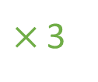
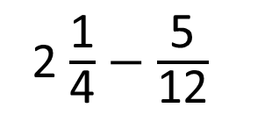
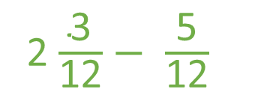
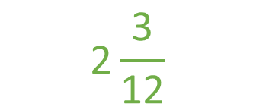
I don’t think you can calculate 2 $\frac{\text{1}}{\text{4}}$ $−$ $\frac{\text{5}}{\text{12}}$
2 $\frac{\text{1}}{\text{4}}$ $−$ $\frac{\text{5}}{\text{12}}$
$×$ 3
$$\text{2}\frac{\text{3}}{\text{12}}$$
2 $\frac{\text{3}}{\text{12}}$ $−$ $\frac{\text{5}}{\text{12}}$
Have a think

Slide 14
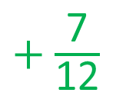
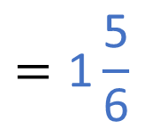
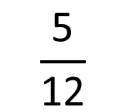
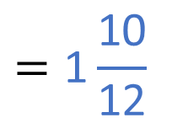
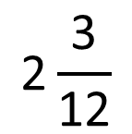
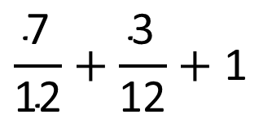
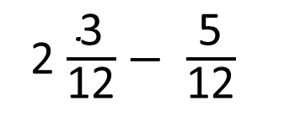
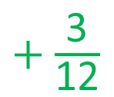
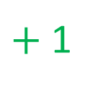
2 $\frac{\text{3}}{\text{12}}$ $−$ $\frac{\text{5}}{\text{12}}$
$\text{+}$ $\frac{\text{7}}{\text{12}}$
$\text{+}$ $\frac{\text{3}}{\text{12}}$
$\text{+}$ 1
0
1
2
3
$$\frac{\text{5}}{\text{12}}$$
$$\text{2}\frac{\text{3}}{\text{12}}$$
$$\frac{\text{7}}{\text{12}}+\frac{\text{3}}{\text{12}}+\text{1}$$
$$=\text{1}\frac{\text{10}}{\text{1}\text{2}}$$
$$=\text{1}\frac{\text{5}}{\text{6}}$$

Slide 15
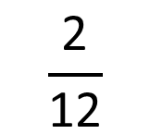
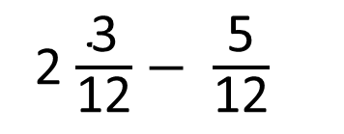

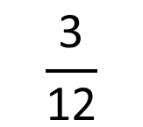
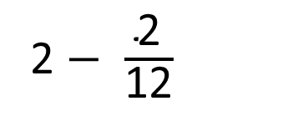
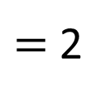
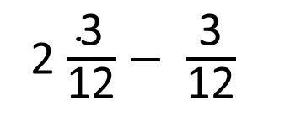
2 $\frac{\text{3}}{\text{12}}$ $−$ $\frac{\text{5}}{\text{12}}$
2 $\frac{\text{3}}{\text{12}}$ $−$ $\frac{\text{5}}{\text{12}}$
2 $\frac{\text{3}}{\text{12}}$ $−$ $\frac{\text{3}}{\text{12}}$
$=$ 2
$$=\text{1}\frac{\text{10}}{\text{1}\text{2}}$$
$$=\text{1}\frac{\text{5}}{\text{6}}$$
2 $−$ $\frac{\text{2}}{\text{12}}$
$$\frac{\text{3}}{\text{12}}$$
$$\frac{\text{2}}{\text{12}}$$

Slide 16
Have a go at the rest of the questions on the worksheet

