Slide 2
22.11.21

Slide 3
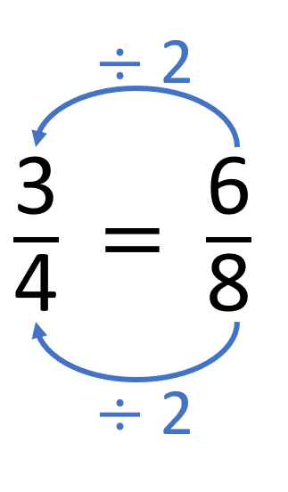
$\frac{\text{7}}{\text{8}}$ $−$ $\frac{\text{5}}{\text{8}}$ $=$
$\frac{\text{2}}{\text{8}}$
$=$ $\frac{\text{1}}{\text{4}}$
Have a think

Slide 4
$\frac{\text{11}}{\text{8}}$ $−$ $\frac{\text{5}}{\text{8}}$ $=$
$\frac{\text{6}}{\text{8}}$
$=$ $\frac{\text{3}}{\text{4}}$

Slide 5
$\frac{\text{13}}{\text{7}}$ $−$ $\frac{\text{6}}{\text{7}}$ $=$
$\frac{\text{7}}{\text{7}}$
$=$ 1
Have a think

Slide 6
$$\frac{\text{3}}{\text{8}}$$
$\frac{\text{3}}{\text{4}}$ $−$ $\frac{\text{3}}{\text{8}}$ $=$
$×$ 2
$\frac{\text{6}}{\text{8}}$
Have a think
$\frac{\text{9}}{\text{15}}$ $−$ $\frac{\text{1}}{\text{5}}$ $=$
$$\frac{\text{6}}{\text{15}}$$
$$\frac{\text{2}}{\text{5}}$$
$$=$$
$×$ 3
$$\frac{\text{3}}{\text{15}}$$

Slide 7
$\frac{\text{5}}{\text{6}}$ $−$ $\frac{\text{12}}{\text{18}}$
$\frac{\text{9}}{\text{10}}$ $−$ $\frac{\text{2}}{\text{10}}$
$$\frac{\text{15}}{\text{18}}$$
$\frac{\text{7}}{\text{8}}$ $−$ $\frac{\text{1}}{\text{16}}$
$\frac{\text{15}}{\text{18}}$ $−$ $\frac{\text{12}}{\text{18}}$
$$\frac{\text{28}}{\text{32}}$$
$$\frac{\text{2}}{\text{32}}$$
$\frac{\text{9}}{\text{10}}$ $−$ $\frac{\text{1}}{\text{5}}$
$\frac{\text{28}}{\text{32}}$ $−$ $\frac{\text{2}}{\text{32}}$
$$\frac{\text{2}}{\text{10}}$$
Have a think

Slide 8
$$\frac{\text{4}}{\text{7}}$$
On Monday Whitney reads for of an hour.
$$\frac{\text{3}}{\text{14}}$$
On Tuesday she reads for of an hour less than on Monday.
For how long does Whitney read on Monday and Tuesday altogether?
M
$$\frac{\text{4}}{\text{7}}$$
Have a think
$$\frac{\text{3}}{\text{14}}$$
T

Slide 9
M
$$\frac{\text{4}}{\text{7}}$$
$$\frac{\text{3}}{\text{14}}$$
T
$$\frac{\text{5}}{\text{14}}$$
$\frac{\text{4}}{\text{7}}$ $−$ $\frac{\text{3}}{\text{14}}$ $=$
$\frac{\text{8}}{\text{14}}$ $−$ $\frac{\text{3}}{\text{14}}=$
$$\frac{\text{5}}{\text{14}}$$
For how long does Whitney read on Monday and Tuesday altogether?
$\frac{\text{4}}{\text{7}}$ $+$ $\frac{\text{5}}{\text{14}}$ $=$
$\frac{\text{8}}{\text{14}}$ $+$ $\frac{\text{5}}{\text{14}}$ $=$
$$\frac{\text{13}}{\text{14}}$$
of an hour

Slide 10
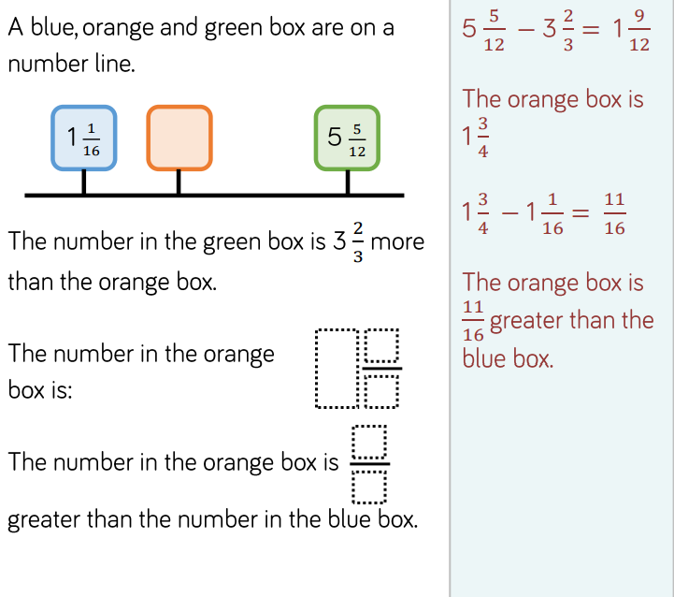
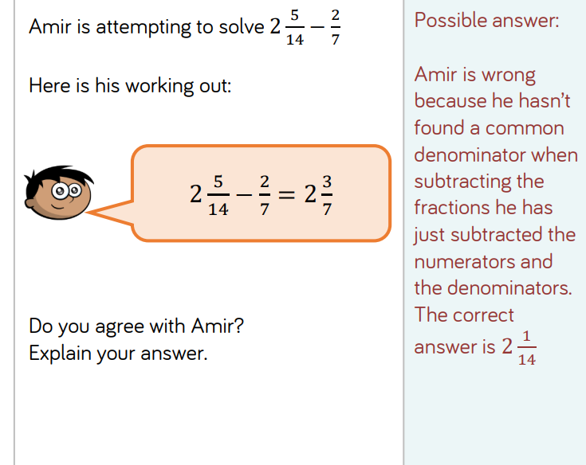
Extension year 5
Extension year 6

