Slide 1
Lesson 4: Making holes
Save a copy
Year 6 – Creating media – 3D modelling
Notes:
Last updated: 01-07-20
This resource is available online at ncce.io/cm6m-4-s. Resources are regularly updated – please check that you are using the latest version.
This resource is licensed under the Open Government Licence, version 3. For more information on this licence, see ncce.io/ogl.

Slide 2
Lesson 4: Making holes
Objectives
To identify that physical objects can be broken down into a collection of 3D shapes
I can identify the 3D shapes needed to create a model of a real-world object
I can create digital 3D objects of an appropriate size
I can group a digital 3D shape and a placeholder to create a hole in an object

Slide 3
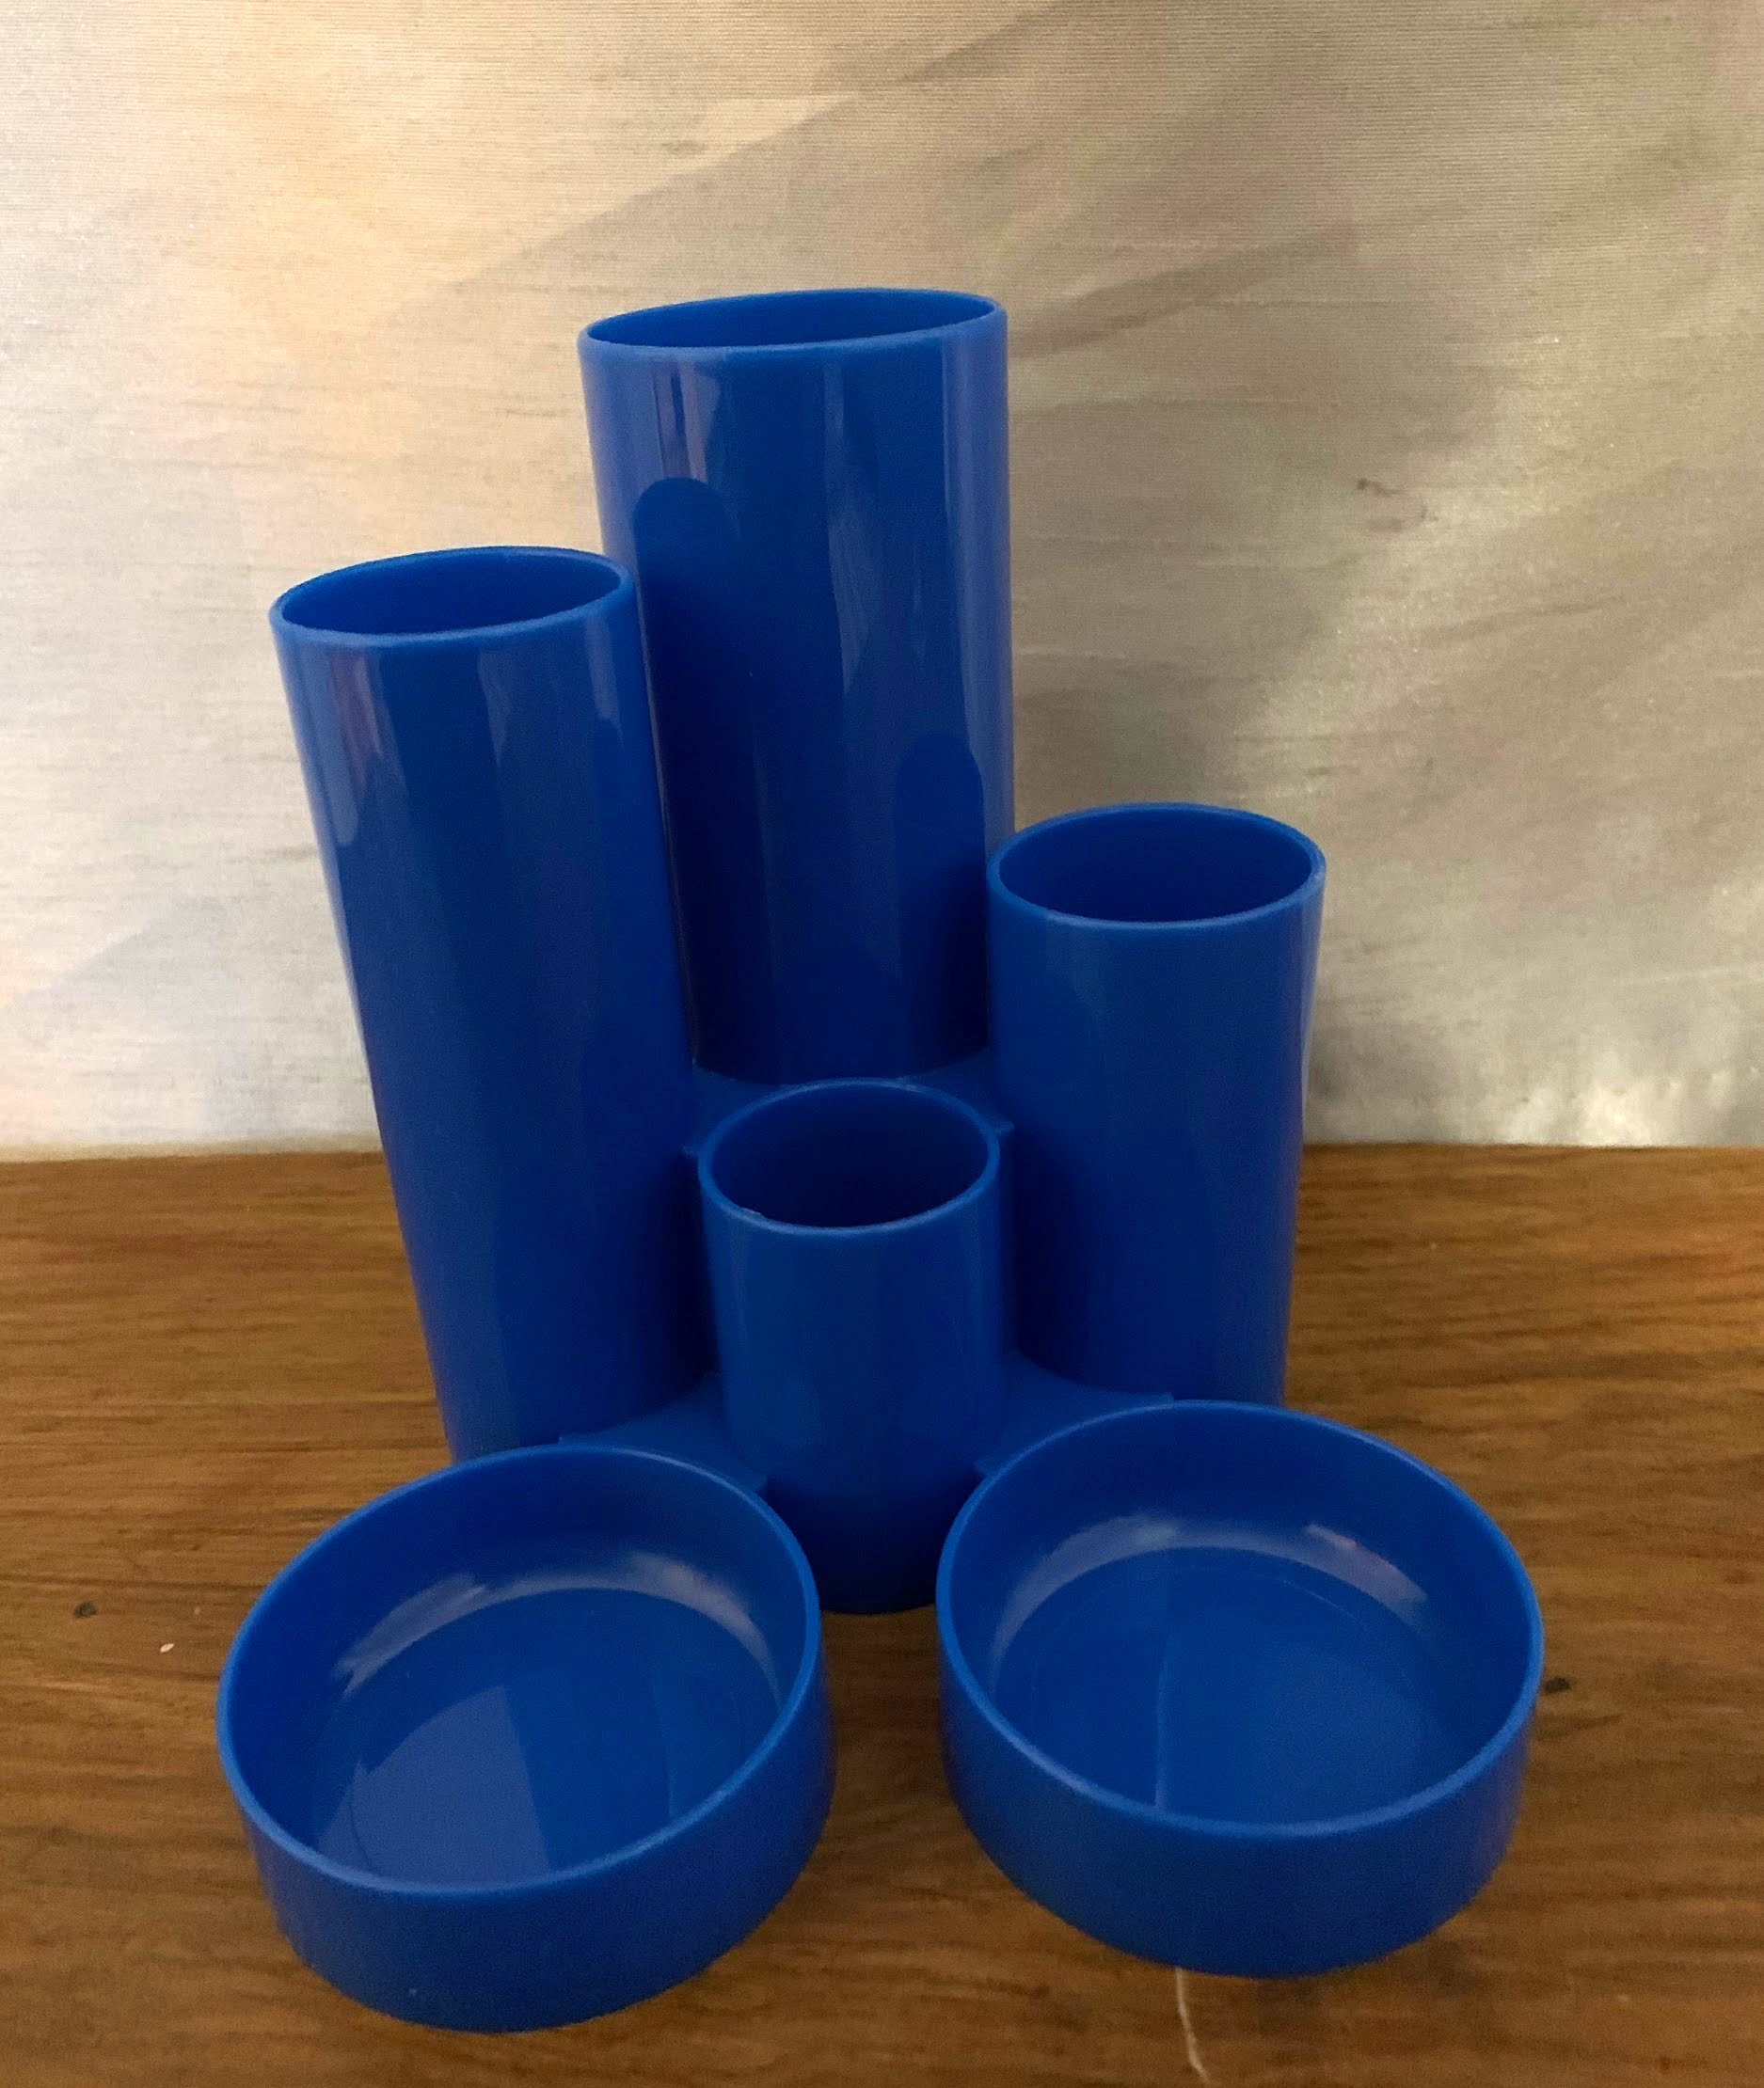
Making 3D models of the correct size
Introduction
You will be using 3D objects on-screen to produce your own 3D model of a pencil holder desk tidy.
In order for all our stationery to be stored, it is important that each part of the model has the correct dimensions, or measurements.
Notes:
Image source: own photo

Slide 4
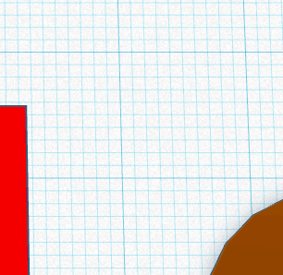
Measurements in Tinkercad
Activity 1
10 mm
Tinkercad displays measurements using millimetres (mm).
On the workplane:
One small square measures 1 mm x 1 mm
One large square measures 10 mm x 10 mm (the same as 1 cm x 1 cm)
10 mm

Slide 5
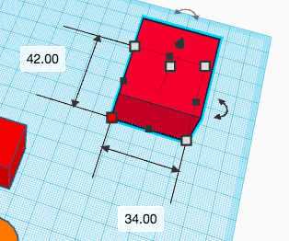
Dimensions of 3D objects
Activity 1
When resizing objects, Tinkercad displays the 3D shape’s dimensions in millimetres.
What does 42.00 mean? How about 34.00?
Could you estimate the 3D shape’s dimensions without resizing it?
How could you view the height of the 3D shape?

Slide 6
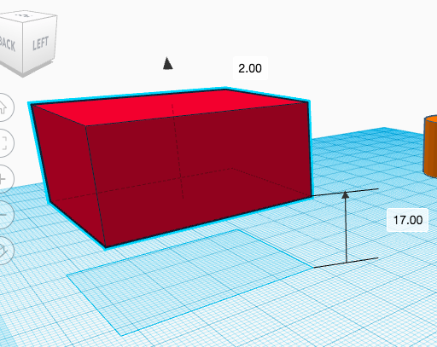
Dimensions of 3D objects
Activity 1
When lifting objects, Tinkercad also displays the distance of the 3D shape from the workplane, or base, in millimetres.

Slide 7
Resizing to specific dimensions
Activity 1
Using the activity sheet, can you create 3D objects with the specified dimensions?
Once you’ve finished, challenge a partner to produce a shape with specific dimensions.
20 mm
100 mm
80 mm

Slide 8
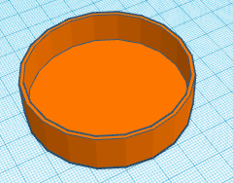
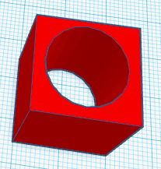
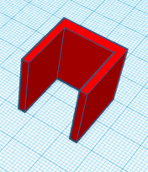
3D objects as placeholders
Activity 2
3D objects can be used as placeholders to create holes in other 3D objects.

Slide 9
3D objects as placeholders
Activity 2
Part of our pencil holder’s base can be made using 3D objects as placeholders.
13 mm
inside
height
60 mm
outside
width
58 mm
inside
width
15 mm
outside
height
1 mm
width of side
2 mm
height of base
Notes:
Image source: own photo

Slide 10
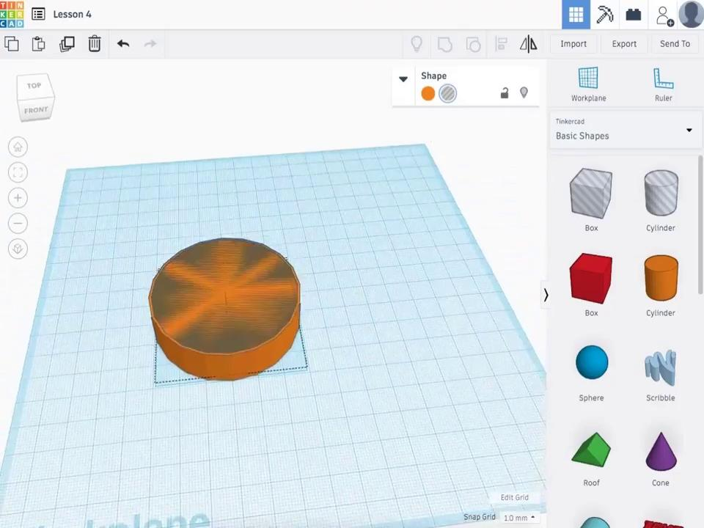
3D objects as placeholders
Activity 2

Slide 11
Grouping 3D objects
Activity 2
What happens when you try to move grouped 3D objects?
Can grouped 3D objects be moved in the same way as ungrouped 3D objects?
Once 3D objects have been grouped, can they be ungrouped?
How can you alter the size of a hole in a solid 3D object?

Slide 12
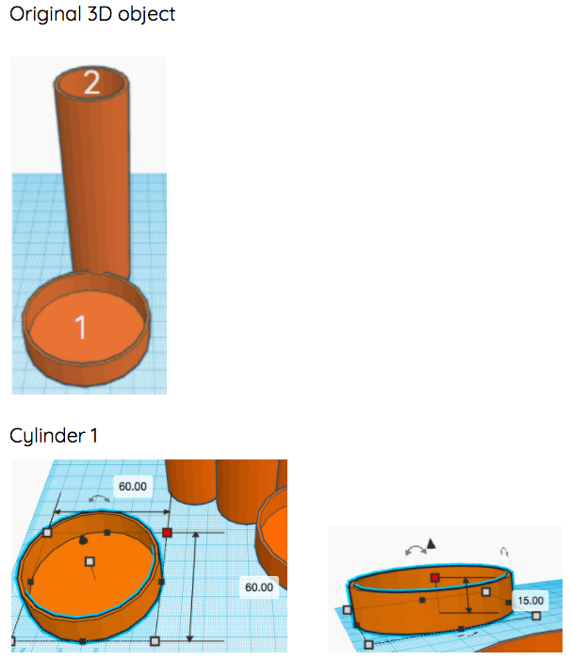
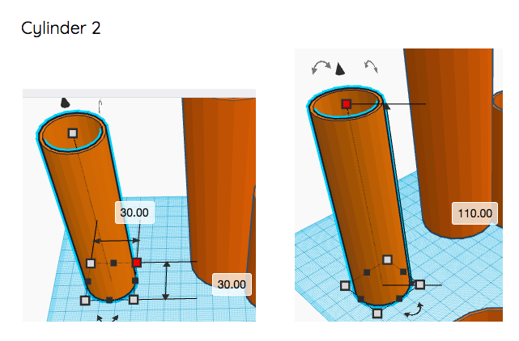
Creating a pencil holder
Activity 2
The height of each section’s base is 2 mm.
The width of each section’s side is 1 mm.
Notes:
Image source: own photo

Slide 13
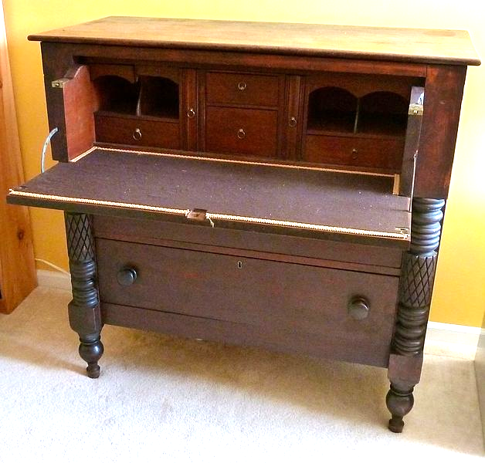
Identifying 3D shapes
Plenary
Our pencil holder was made up of many cylinders.
Real-world objects can contain many 3D shapes.
What 3D shapes can you identify within this object?
Notes:
Image source: https://commons.wikimedia.org/wiki/File:ButlersDesk.jpg
Licence: https://creativecommons.org/licenses/by-sa/3.0/deed.en (image lightened)

Slide 14
How confident are you? (1–3)
Assessment
I can identify the 3D shapes needed to create a model of a real-world object
I can create digital 3D objects of an appropriate size
I can group a digital 3D shape and a placeholder to create a hole in an object
3 – Very confident
2 – Unsure
1 – Not confident
Notes:
Image source: https://pixabay.com/vectors/thumb-up-hand-like-confirm-go-top-307176

Slide 15
Next lesson
Summary
In this lesson, you...
Used 3D objects as placeholders to make holes in other 3D objects, in order to create a pencil holder desk tidy
Next lesson, you will…
Plan your own design for a photo frame.

