Slide 1



  Telford & Wrekin
  Healthy Child Programme
  (0-19) Service
  Public Health Nursing
Improving Lives In Our Communities

Slide 2
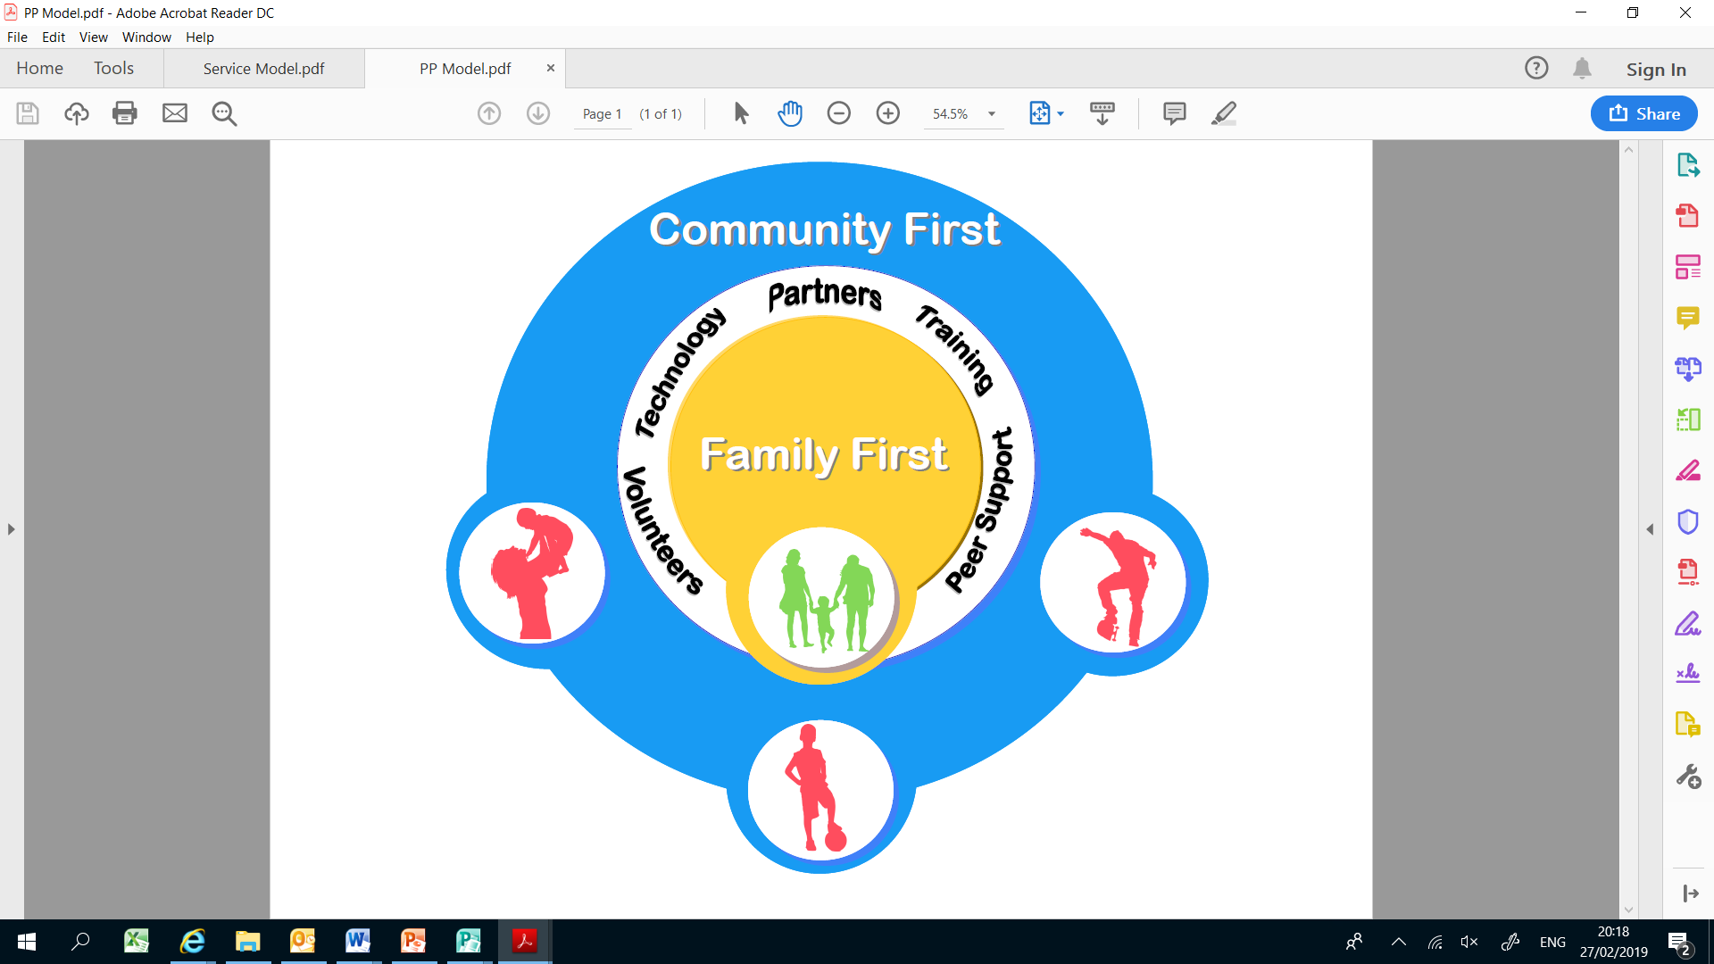
Telford & Wrekin Healthy Child Programme
(0-19) Service Model
Improving Lives In Our Communities
Notes:
Caroline
The new model of service delivery has been developed specifically for the needs of the Telford & Wrekin population.
Child at the centre
Relationships/partnerships
To enable us to work in a more effective and efficient way we propose a model that moves away from the traditional three borough based teams to one needs led service that will cover the whole of Telford and Wrekin.
This model will be made up of three distinct layers with the child and family at the centre.
The HCP (0-19) service is made up of two distinct needs led teams. The child and family will move in and out of the two teams according to need with the expectation that the majority of families will receive universal support from the Community First team
Four core outcomes of the new HCP (0-19) Service
• Parents/carers are able to provide an assuring, safe, stable and nurturing environment for their children/young people
• Families have good mental health and emotional wellbeing
• Families are resilient
• Families feel included in their community

Slide 3
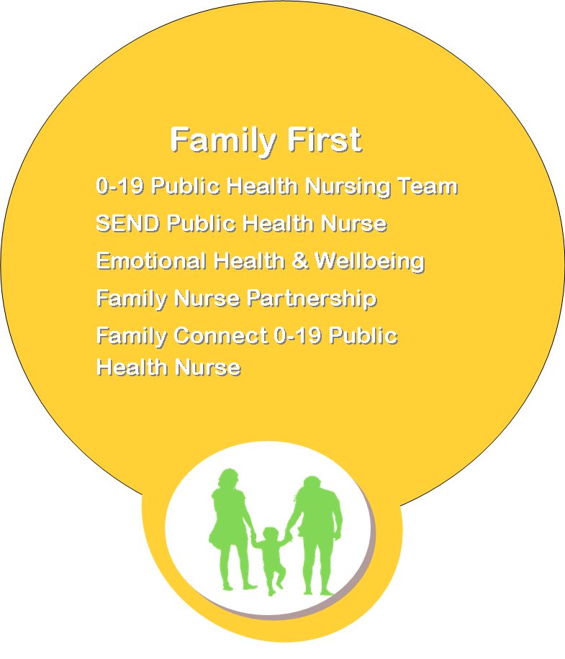
Family First
Partnership Plus
Evidenced based model
Enable multi-agency working
Referrals for the most vulnerable families with the most complex and/or additional needs
Training /Supervision
Improving Lives In Our Communities

Slide 4
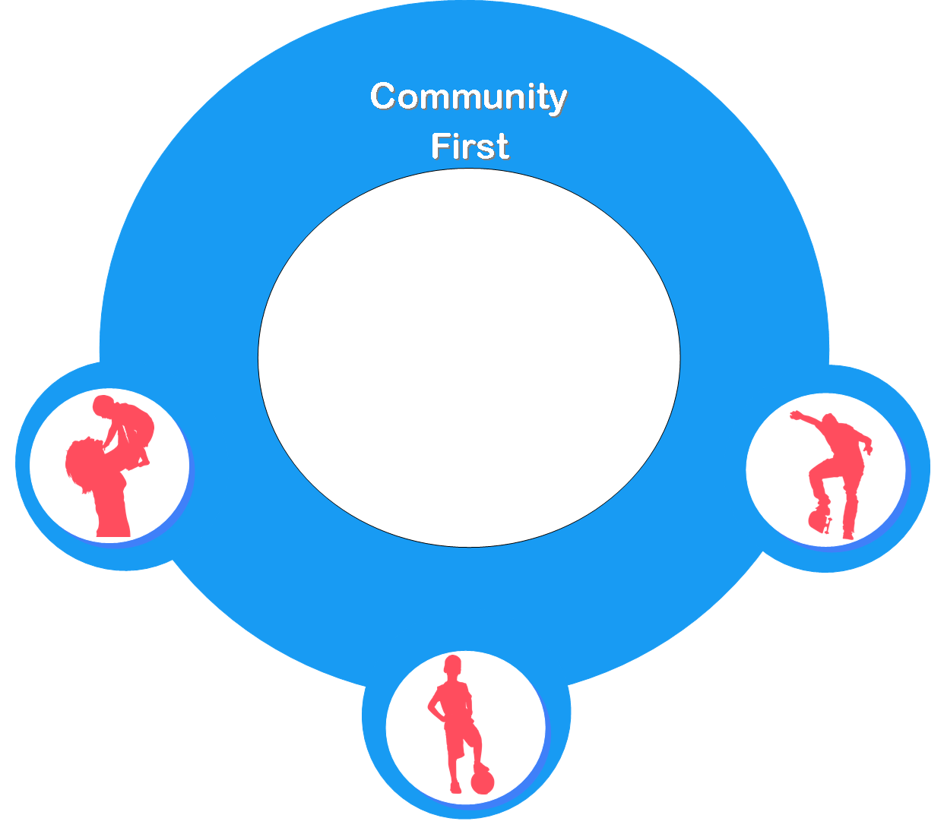
Community First
Public Health Prevention & Universal
Universal & Universal Plus Contacts – NCMP & 5 Mandated contacts
Single point of access for referrals
Early Help Assessment
Community Public Health Clinics
12 month rolling program for Primary & Secondary Schools
Improving Lives In Our Communities
Notes:
Public health clinics not just established clinics in schools & GPs but development of clinics working in partnership with Healthy Families, e.g Sleep, behaviour , healthy eating/exercise in collaboration with our healthy lifestyles teams as we are currently looking at opportunities to work together in school and community venues ie. HLC school nursing drop in is on the same day the healthy lifestyles attend to support more collaborative w
working. Healthy Lifestyles in Well Baby clinics. 0 -19 service starting work with Pre- conception work with YMCA 16 +
12 month rolling programme will offered to schools Asthma and Anaphylaxis - HPV year 8’s Assemblies year 7 health drop ins healthy lifestyles Year 8 HPV assemblies - Year 9, 10, 11 child sexual exploitation CSE check list/ targeted assemblies and health promotion. WALLET SIZED CARDS TO TAKE TO PHARMACY AFTER SEEING SCHOOL NURSE DROP IN AND THEY WILL BE SEEN STRAIGHT AWAY – FROM CSE TRAINING WITH PHARMACISTS.
Generic healthily lifestyles, weight management , emotional health and well being – Future In Mind etc, smoking, sexual health – chlamydia testing, pregnancy testing, CSE teenage pregnancy . Emergency Contraception Signpost young people to appropriate services on line KOOTH, BEAM , BU etc

Slide 5


  School Population
  44,300 children/young people - 5 -19 Staffing.
  Number of Primary Schools: 47
  Number of Secondary Schools: 12
  SEND x1 Primary x1 Secondary
  Alternate Education Provision x 5
  Health Visiting
  10, 700 children 0 - 5 (mandated contacts 5)
  All new birth visits and 6 -8 week contacts seen at home. 1yr and 2yr developments majority completed in clinics.
  Case loads; 462 children per 1 WTE Health Visitor
Improving Lives In Our Communities

Slide 6


  Electronic Referral direct request for support for children (with consent from parents).
  Referral triaged and allocated to appropriate practitioner
  The 0-19 service does not have access to GP records
  The 0 -19 service is not an emergency service
  Health Visitors are available following the 2½ year development review, to support health & development queries and to support school readiness.
  Nursery Nurse advice telephone line for sleep, fussy eating, behaviour and toileting. Pilot.
  School Readiness clinics run by Health Visitor Nursery Nurses/School Readiness support worker linking with nurseries/primary schools.
  Seamless transfer from health visiting 0-5 ; to school nursing 5 -19 years.
Improving Lives In Our Communities

Slide 7

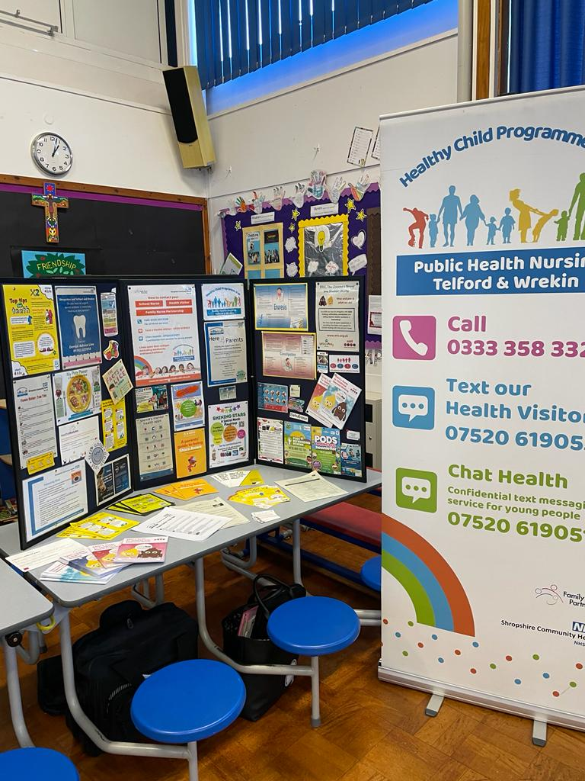



School Readiness
Improving Lives In Our Communities

Slide 8








Improving Lives In Our Communities
Your Health Visiting Team
School Readiness Workshops what we can offer you:
Our School Readiness staff member will be able to give: advice, support and signpost to resources on toileting, behaviour, sleep, fussy eating and dental health. The support will be available through targeted health promotion workshops and activities with parents in partnership with your nursery. By identifying development concerns early, we can provide support through targeted interventions and early referrals to support parents and ensure children are equipped and ready for school.
Our experienced Nursery Nurses run a School Readiness clinic every Wednesday, at Stirchley Medical Practice (appointments available upon request via the number below).
Ask your nursery to refer in or self-refer by calling
0333 358 3328
What we don’t do:
We no longer check hearing and sight in reception
We are not a diagnostic service however we are able to sign-post to appropriate services/support
How and when to get your child’s eyesight checked:
You can attend most opticians and book a sight check for your child
Please follow this link to find a local optician: Sight Tests - NHS (www.nhs.uk)
Checks are free on the NHS for children
It is best to get your child’s sight checked before they start school and then yearly thereafter.
They will ensure your child’s sight and eye health is monitored and issue glasses if required.
How to get my child’s hearing checked:
Should you notice an issue with your child’s hearing, or you are alerted by school there maybe an issue you should attend your local GP who will be able to examine the ear canal and rule out infection. The GP can also refer for a hearing test if necessary.
A school nurse can also do an audiology referral

Slide 9
Improving Lives In Our Communities
Your School Nurse
What we can offer you:
Children will have their height and weight measured in reception and year 6 (unless opted out of). More information and help can be found at National Child Measurement Programme - NHS Digital
Advice, support, and signposting to resources on toileting, behaviour, healthy lifestyles, emotional and mental well-being.
Our Emotional health and wellbeing lead nurse also runs a clinic for parents every Monday, 9-2pm at Sutton Hill Medical Practice (online appointments also available upon request via the number below).
Ask your school to refer in or self-refer by calling 0333 358 3328
What we don’t do:
We no longer check hearing and sight in reception
We are not a diagnostic service however we are able to sign-post to appropriate services/support
How and when to get your child’s eyesight checked:
You can attend most opticians and book a sight check for your child
Please follow this link to find a local optician: Sight Tests - NHS (www.nhs.uk)
Checks are free on the NHS for children
It is best to get your child’s sight checked before they start school and then yearly thereafter.
They will ensure your child’s sight and eye health is monitored and issue glasses if required.
How to get my child’s hearing checked:
Should you notice an issue with your child’s hearing, or you are alerted by school there maybe an issue you should attend your local GP who will be able to examine the ear canal and rule out infection. The GP can also refer for a hearing test if necessary.
A school nurse can also do an audiology referral

Slide 11











Strengthening Families
Resources:
Playing Together
Improving Lives In Our Communities

Slide 12
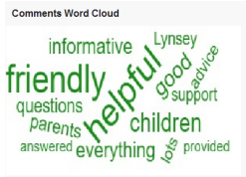

Slide 13

  Thank you
Improving Lives In Our Communities

