Slide 1


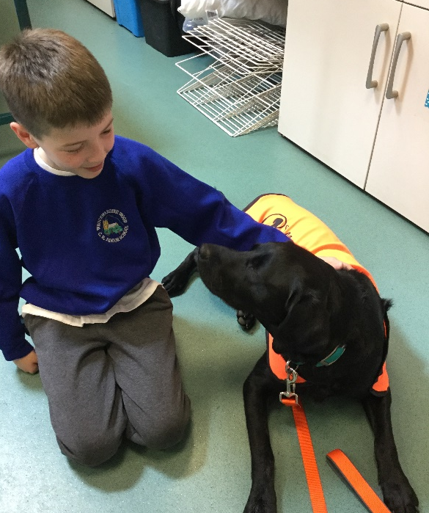
WELCOME
NALA
OUR NEW

Slide 2
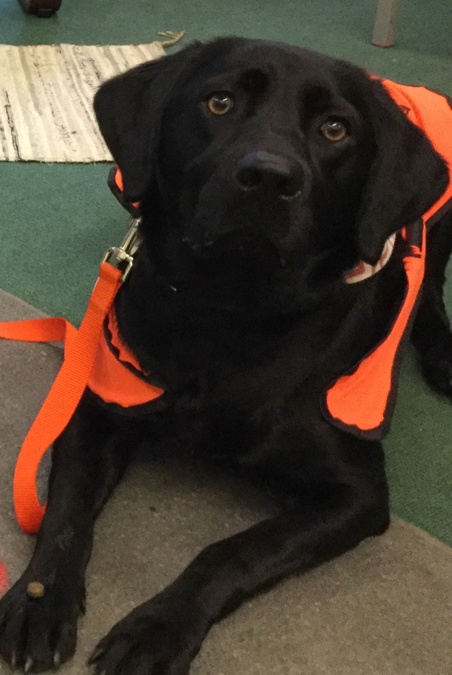

Hello I am now training to be a dog mentor. I am here to help you every day in lots of different ways. Most importantly I'm here to be your friend. There are lots of ways that you can help me to be happy and safe in school...

Slide 3
working with the dog mentor
  There should be no more than two people around me at a time
  Always ask before stroking me
  If given permission to stroke the me, you must lower yourself to the ground
  Approach me using your Dog Mentor breathing
  Stroke me from the chest or shoulder down to the tail
  Never reach over the top of my head
  You should not ruffle my fur

Slide 4
playground
  When approaching me, try not to shout or be over-excited as I may get scared
  No running towards me
  Never stroke me when standing behind me
  If you are playing with a ball try to keep the ball from travelling in my direction
  I don't like it when people crowd around me - always ask permission to approach

Slide 5
CLASSROOM
  * Sit in your seat
  Keep your feet still and flat on the floor
  Keep your hands on the table
  Use your dog mentor breathing
  Only stroke me if told to do so
  Do not put food waste in the bin on the floor it must go in the bin outside
  Be quiet and don’t call my name

Slide 6
moving around the school
  Always walk around the school sensibly
  Don't reach out to touch me when I'm passing
  Use indoor voices
  Try to keep my name inside your head rather than shout it out
  In the Dog mentor Zone be very quiet as I may be having my break and a nice sleep.

Slide 7
WHAT I WILL BE DOING
  Working with you to learn new words and commands.
  Listening to your read one of my books.
  Walking with you.
  Playing fetch
  Having regular water and walk breaks monitored by my helpers
  .

Slide 8
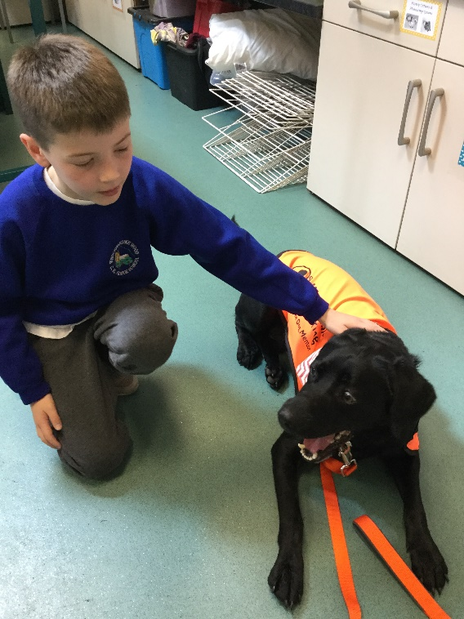

I can’t wait to work with you all I am really looking forward to being a part of your school!

